Slide 1
Data & Knowledge Management
Presented by
Clayton J. Hamilton, PharmD
Program and Data Management
Veterans Affairs – National Academic Detailing Service
Clayton.Hamilton@va.gov
Notes:
Introductions:
- Name
- Favorite hobby

Slide 2




Objectives
Differentiate between structured versus unstructured EMR data
Summarize high level concepts for EMR data transactions and data warehousing
Describe key elements of a relational database.
Formulate simple SQL queries using a basic understanding of language syntax
*EMR = Electronic Medical Record

Slide 3
Databases & Healthcare – My story
PGY1 at the Fort Harrison VA Medical Center in Helena, MT.
Identified missed opportunities for improved care
Learned about patient dashboards during anticoag rotation
Pursued PGY2 in Pharmacy Outcomes and Health Care Analytics
Using data to improve patient care through population health management

Slide 4




Why specialize in informatics as a pharmacist?
Multiply your impact on a patient population
Improve health care quality and patient safety
Support clinical research projects
Lead the data revolution in health care
Notes:
Explain why I chose to pursue informatics during PGY1.

Slide 5
Medical Data Pipeline - Overview

Slide 6
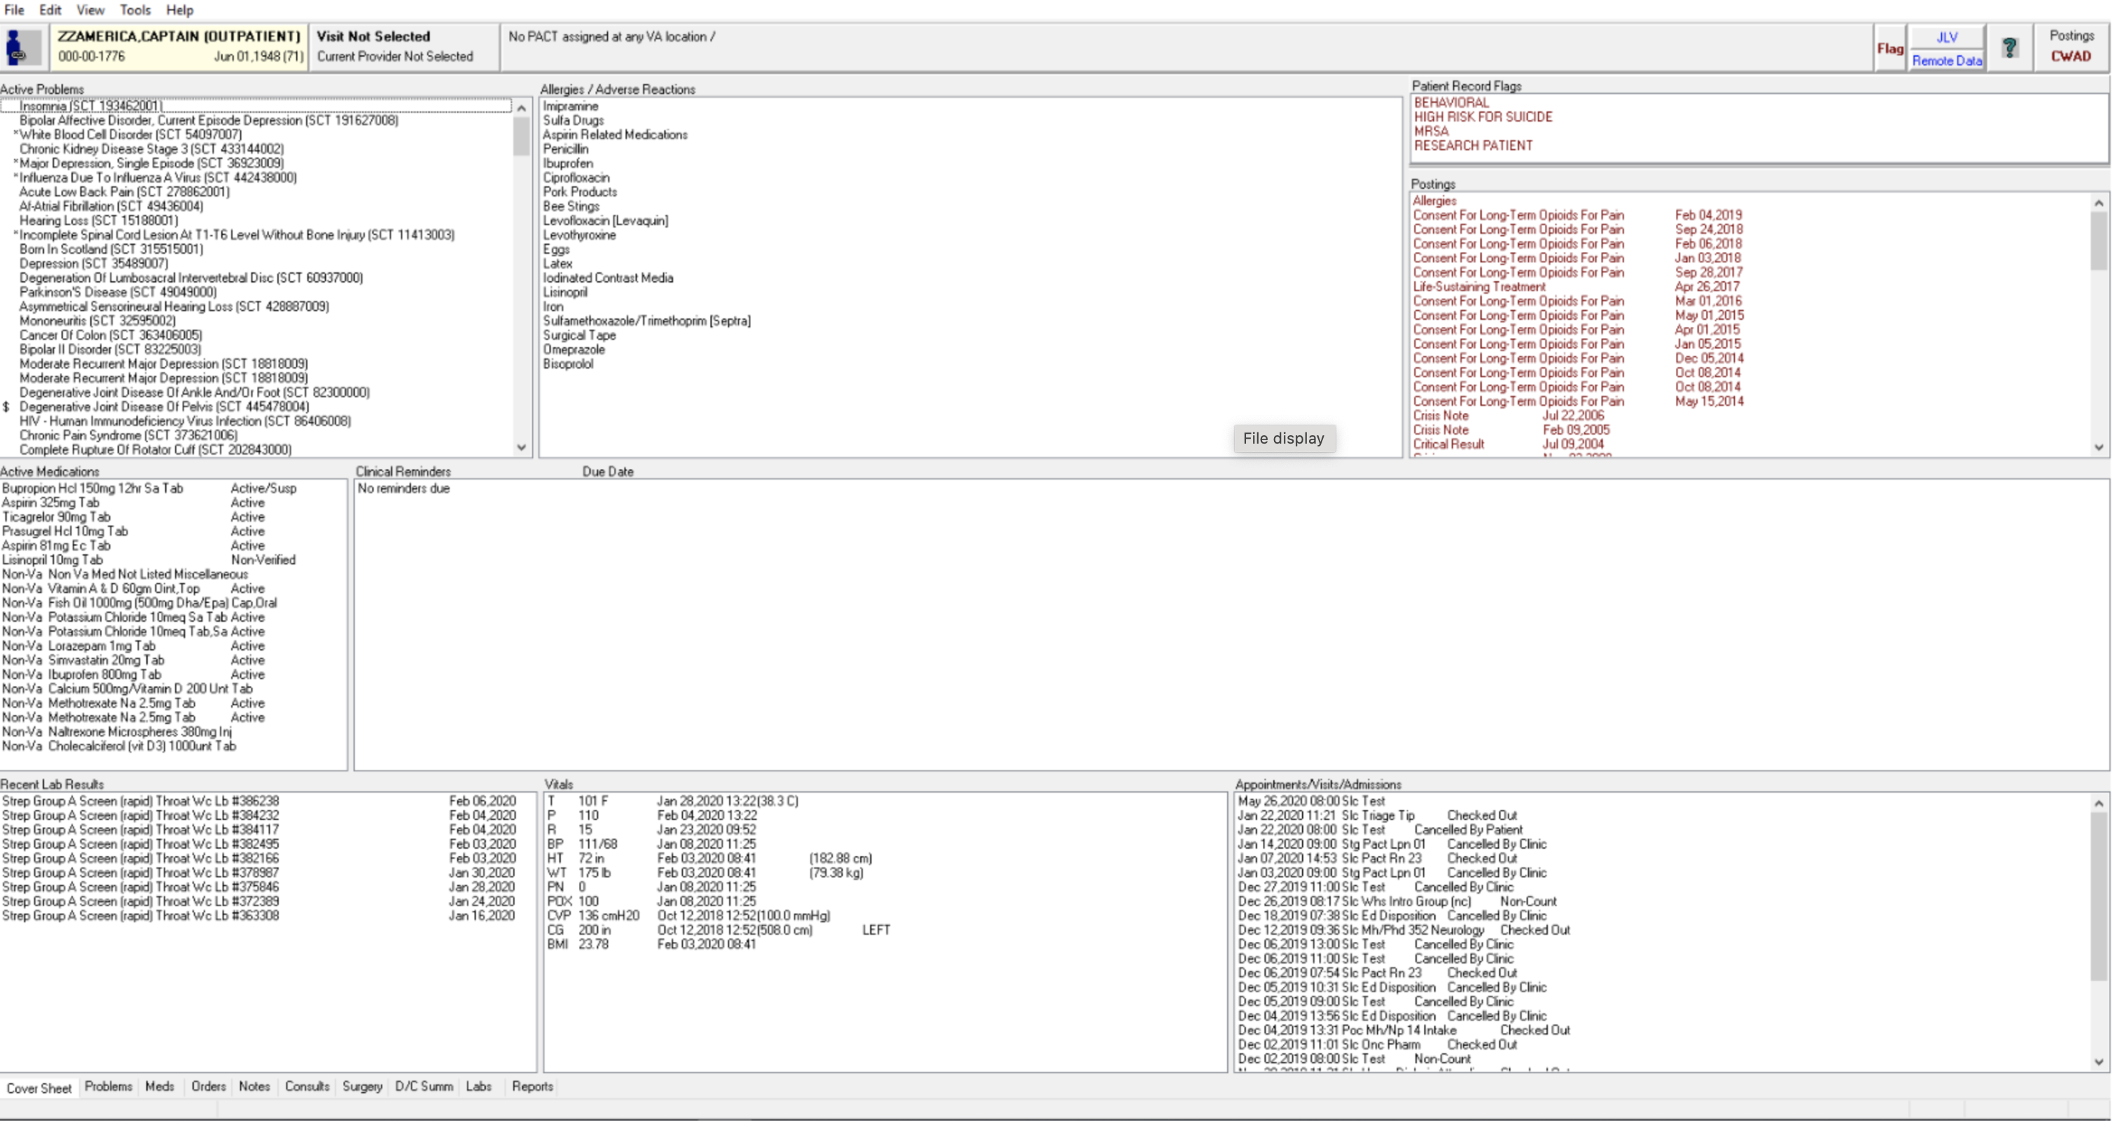
VA Computerized Patient Record System (CPRS)
*GUI: Graphical User Interface
*GUI: Graphical User Interface
Notes:
It all begins with the EHR software that the user interacts with on a daily basis to record new patient information.
It’s important to understand that the EMR is a piece of software

Slide 7
Transactional Data
Any information entered into the electronic medical record (EMR)
Single transactions are the base unit of the entire EMR
Communicate completed work to other users
Records management: The process of retaining transactions for future use
Notes:
End-user error is found in data. Important to understand your processes within the system to determine what can/can’t be trusted.

Slide 8



Transactional Data Structure
Structured data
Semistructured data
Contains both structured and unstructured data
Example: cellphone photos
Unstructured data
Fits a pre-defined model
Much easier to process/query
Examples: dates, lab data, SSNs, phone numbers, NDCs
No predefined model
Much more process intensive to query
Example: raw text, video, audio recordings
What type of data is this PowerPoint?

Slide 9
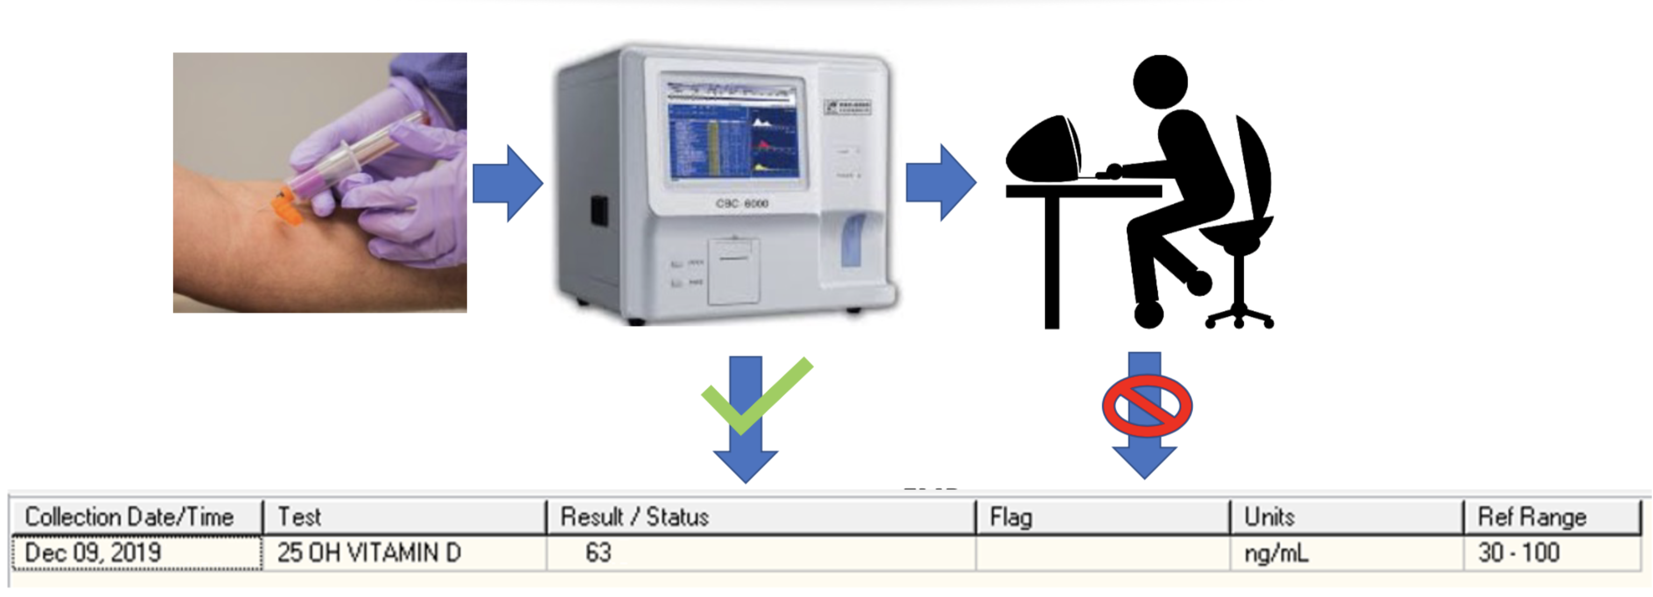
Transactional Data: Structured Lab data entry
Every EMR has it’s own specific limitations
Notes:
End-user data entry error is commonly found in data. It is important to understand how processes work within your health care system to determine what can/can’t be trusted.

Slide 10
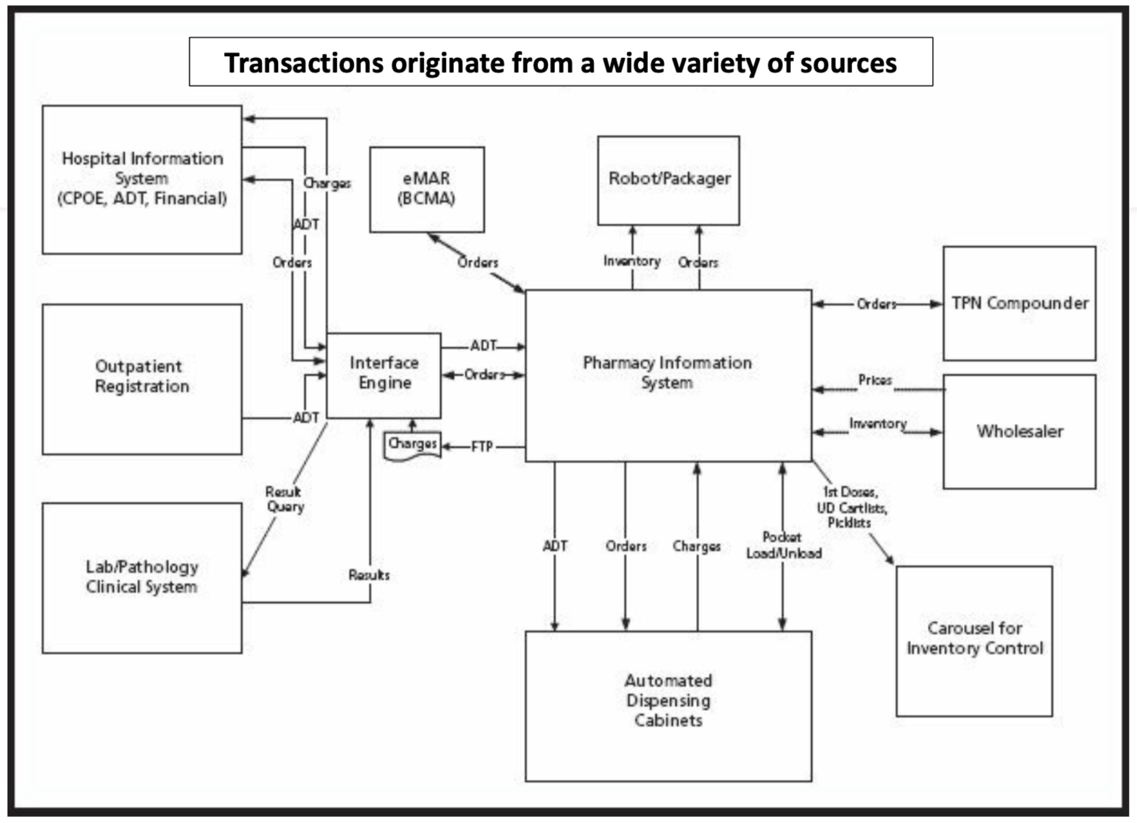
Notes:
Interoperability

Slide 11
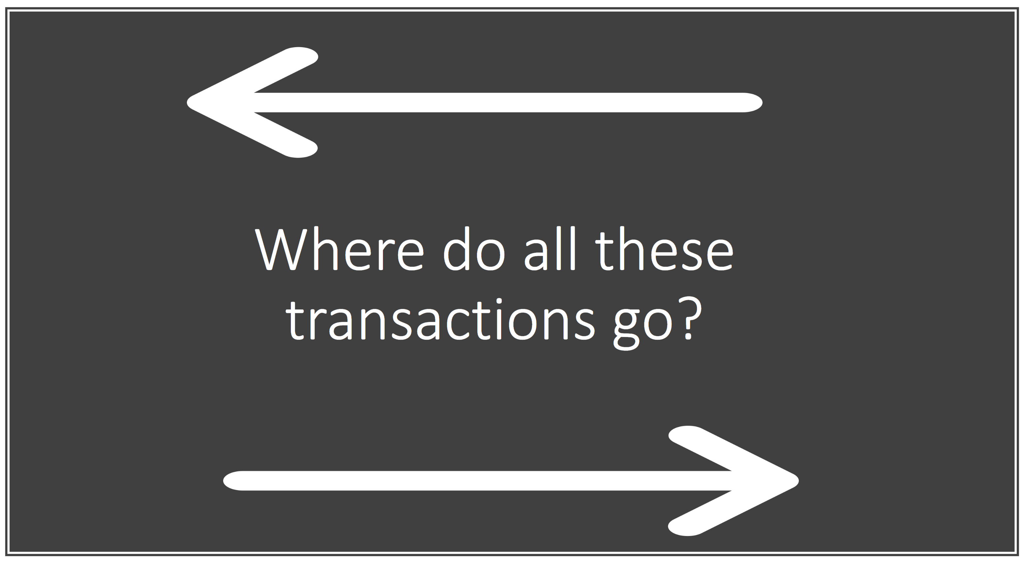

Slide 12

The short answer: Data Warehouse(s)
Contains football fields of servers
Gathers, transforms, and stores health data in databases
Access to the data warehouse grants users the ability to provide accurate management information and supporting data analysis

Slide 13
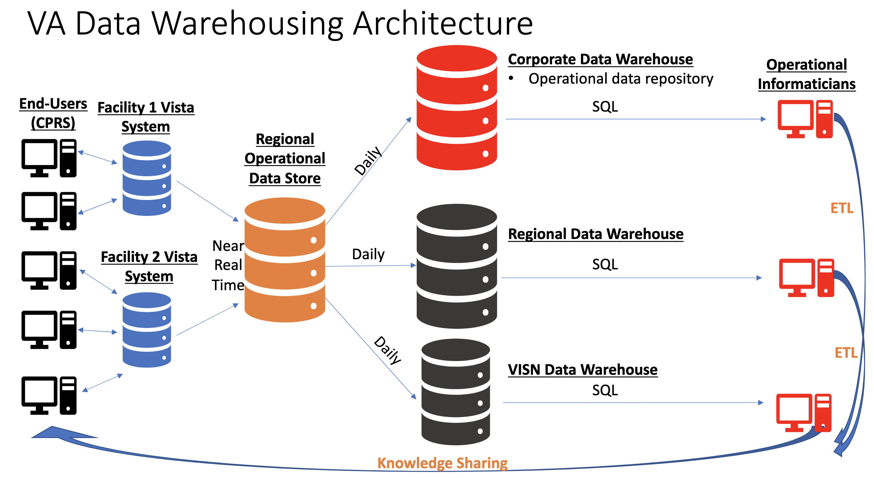

Slide 14

The Relational Database
A database is a repository of data
Structured data is typically stored in tables similar to spreadsheets
Tables can be joined/linked together through shared columns
Goal is to store a piece of data only once (normalization)
Why not have one spreadsheet with all the data in it?

Slide 15
Denormalized Data
Table Name: RxFill
PatientName | Age | DrugName | FillDate | Qty | DaysSupply | FormularyFlag | PricePerUnit
Smith,John | 55 | Atorvastatin | 2021-01-05 | 30 | 30 | Y | 0.05
Smith,John | 55 | Atorvastatin | 2021-02-10 | 30 | 30 | Y | 0.05
Johnston,Smith | 65 | Metformin | 2021-01-05 | 60 | 30 | Y | 0.01
Johnston,Smith | 65 | Metformin | 2021-02-11 | 60 | 30 | Y | 0.01
Note how the yellow columns contain duplicate data
Increases required storage space and data processing time
This duplication becomes non-trivial when this data model is applied to millions of patient records
Notes:
Why “relational”? Describe normalization. Each row is the name of each column within the table (column header)

Slide 16
Normalized/Relational Database Diagram
Table Name: RxFill
RxFill_ID | Patient_ID | Drug_ID | FillDate | Qty | DaysSupply
1 | 1 | 1 | 2021-01-05 | 30 | 30
2 | 1 | 1 | 2021-02-10 | 30 | 30
3 | 2 | 2 | 2021-01-05 | 60 | 30
4 | 2 | 2 | 2021-02-11 | 60 | 30
Patient_ID
Drug_ID
Table Name: Patient
Patient_ID | PatientName | Age
1 | Smith,John | 55
2 | Johnston,Smith | 65
Table Name: Drug
Drug_ID | DrugName | FormularyFlag | PricePerUnit
1 | Atorvastatin | Y | 0.05
2 | Metformin | Y | 0.01
What other supporting tables might you find in a pharmacy database?
Notes:
Why “relational”? Describe normalization. Each row is the name of each column within the table (column header)

Slide 17
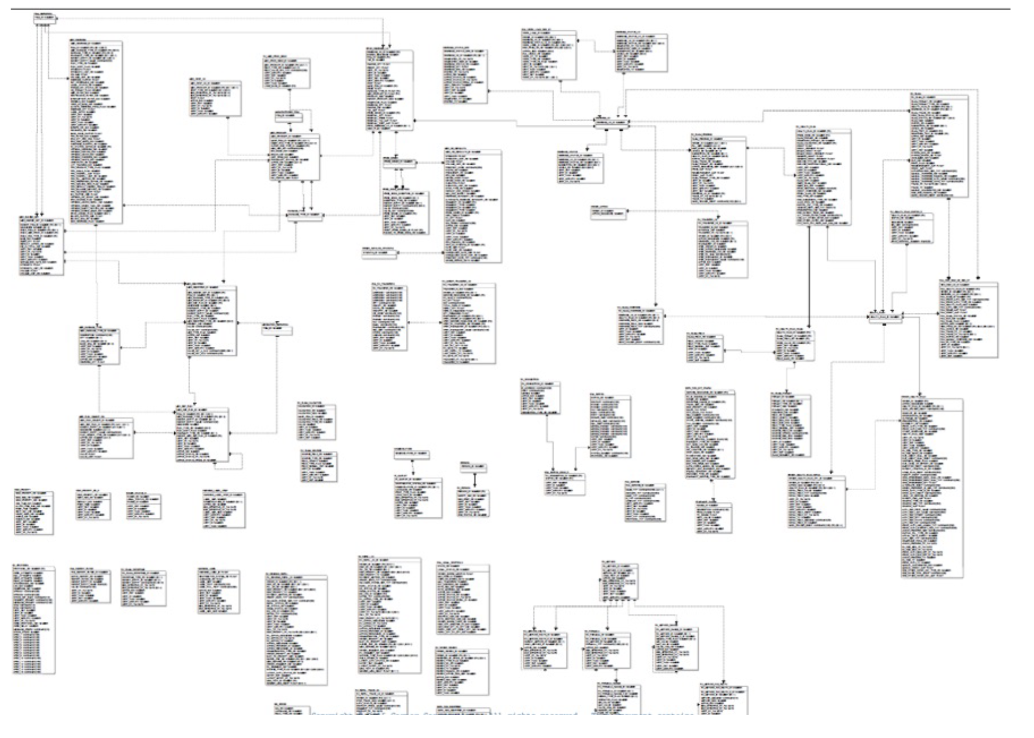
Pharmacy Relational Database Diagram Example
Notes:
Example of what an outpatient pharmacy database can look like.

Slide 18
Retrieving Structured Medical Data

Slide 19
Examples with practice database

Slide 20
What is SQL?
Structured Query Language
Used to communicate with data within a database
Code is written in an user-interface that is connected to the database
Critical data operations:
  Accessing
  Updating
  Inserting
  Manipulating
  Modifying

Slide 21
Basic structure of a SQL query
Select [Column1Name]
, [Column2Name]
From [DatabaseName].[Schema].[Table]
Where ….[insert expressions for column filtering here]
Order by [ColumnName];

Slide 22
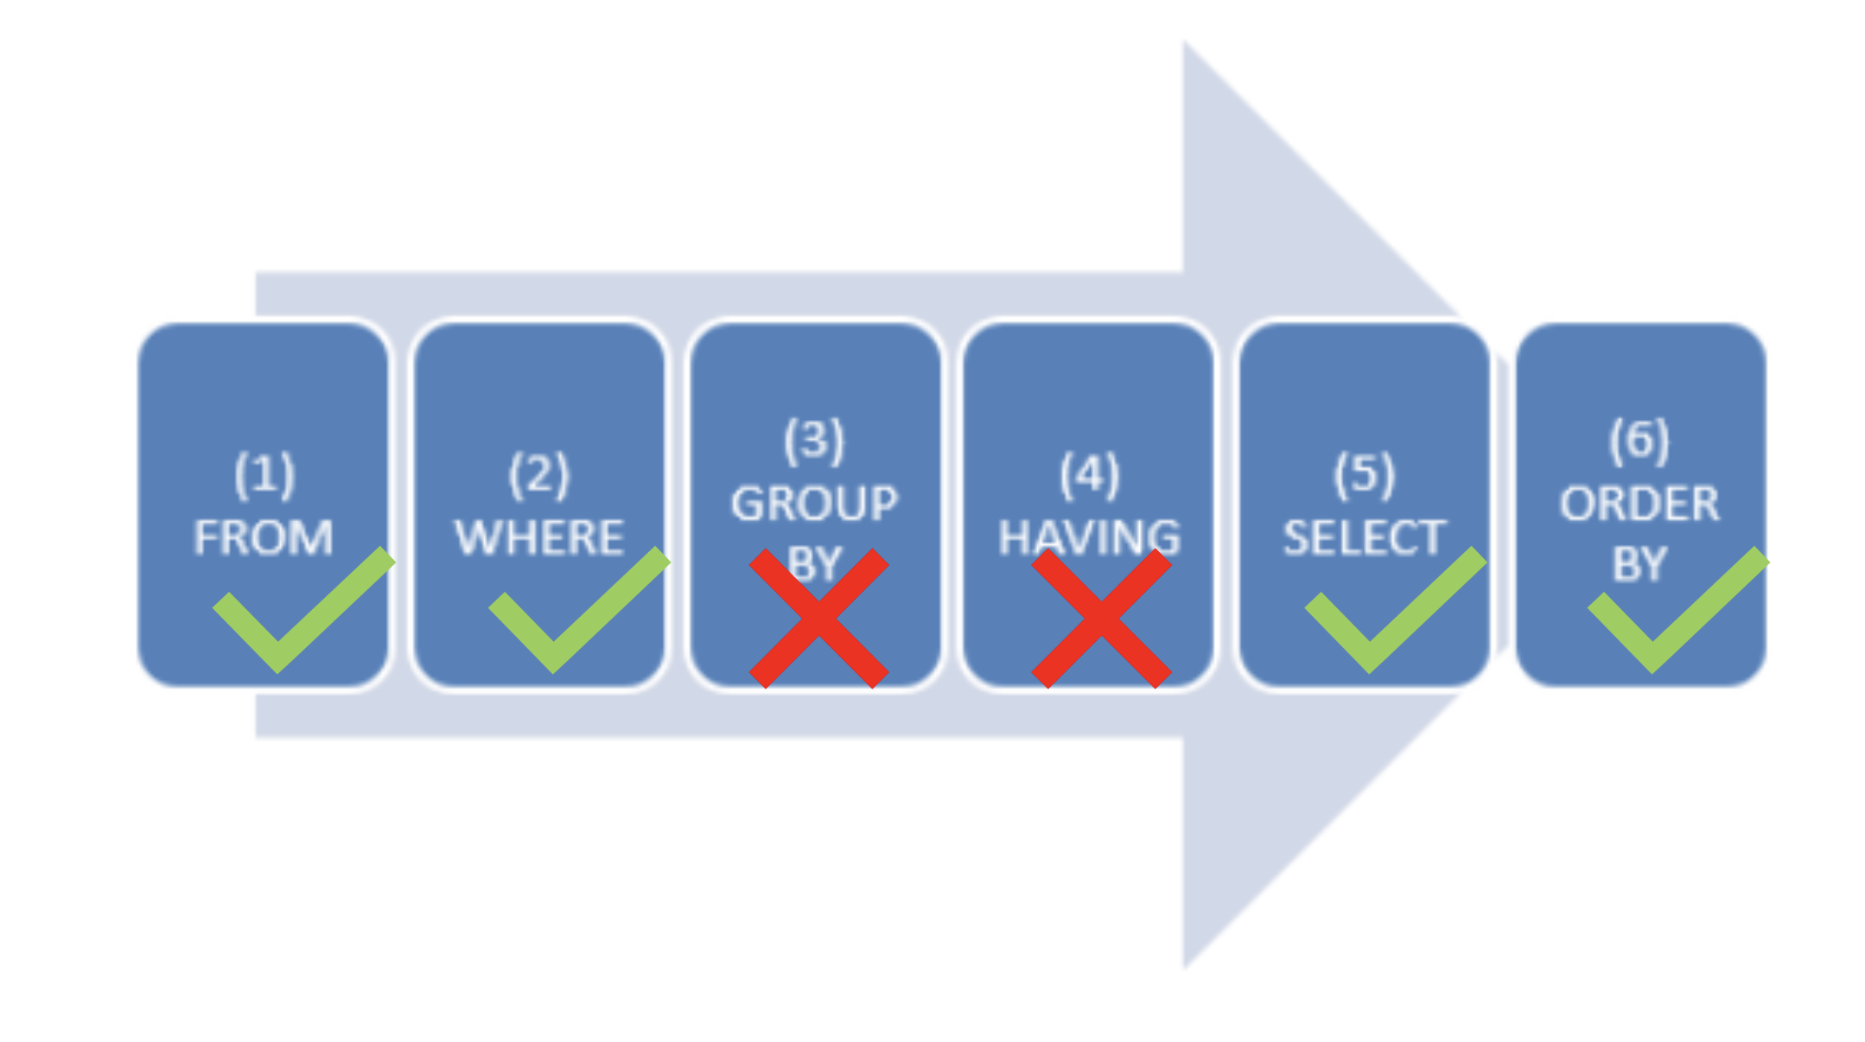
Order of processing
Notes:
Will review in this order.
Group by and having are outside of the scope of this introduction.

Slide 23

FROM Clause
Indicates which database table the query will retrieve data from
Format:
FROM Database.Schema.TableName
Select *
From Pharm.mockpharmacydata
Where DispensedDate >= '2019-10-01’
Order by DispensedDateTime;

Slide 24
WHERE Clause Comparison Operators
Applies filters to the table
Comparison | Symbol
Equal to | =
Greater than | >
Lesser than | <
Greater than or equal to | >=
Less than or equal to | <=
Not equal to | <>
Select *
From Pharm.mockpharmacydata
Where DispensedDate >= '2019-10-01’
Order by DispensedDateTime;

Slide 25
SELECT Clause
Indicates which database column(s) will appear in the results set
Tip: Select * means “select all columns”
Select [Column1]
,[Column2]
,……
From Pharm.mockpharmacydata
Where DispensedDate >= '2019-10-01’
Order by DispensedDateTime;

Slide 26
ORDER BY Clause
Indicates which column(s) the results will be sorted by
Select [Column1]
,[Column2]
,……
From Pharm.mockpharmacydata
Where DispensedDate >= '2019-10-01’
Order by DispensedDateTime;

Slide 27
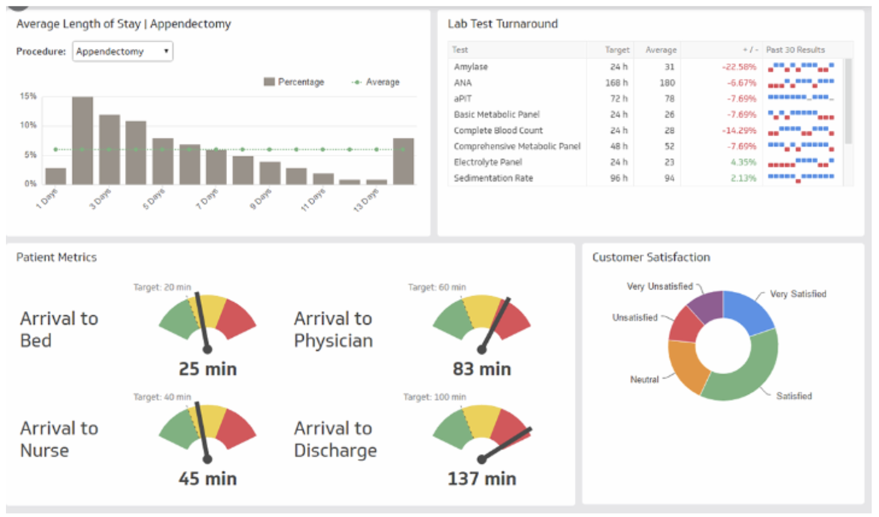
Clinical Dashboards and Performance Reports
Electronic reports can be built to share data pulled using SQL
Many software applications exist:
  SQL Server Reporting Services (SSRS)
  Power BI (Business Intelligence)
  Pyramid Analytics
  Tableau

Slide 28
Databases & Healthcare – Case Study
Background
VA CARES: a pharmacist-led telehealth oncology med management program supporting 3 medical centers
Serves rural Veterans receiving oral antineoplastic therapies prescribed by non-VA providers
Problems
Asynchronous pre-enrollment data needed along with process tracking
Need to determine if there are cost-savings associated
Solution
Developed an internal patient enrollment app to track status and data needed from non-VA providers
Developed a dashboard that tracks patient data
Retrieved data captured in clinician notes to support implementation scientist’s cost savings analyses
Passey D, Healy R, Qualls J, Hamilton C, Tilley E, Burningham Z, Sauer B, Halwani A. Development and implementation of a pharmacist-led telehealth medication management program for veterans receiving oral antineoplastic therapies through the MISSION Act, American Journal of Health-System Pharmacy. 2022 Jun;79(11):835-843.

Slide 29
Key Points
Pharmacists are well positioned to merge clinical and data knowledge
Understanding the fundamentals of how data is captured and retrieved allows for rapid analysis of your patient population
Structured Query Language (SQL) allows you to interact with a database
Data can be presented to leadership/clinicians to support decision-making

Slide 30
Next steps (optional)
Follow the steps outlined in my GitHub repository to create your first database
Follow the DataManipulationScript.sql to practice executing and writing queries
Review the data, ask questions about the data, attempt to answer those questions using SQL

Slide 31
Questions?

